Slide 1
ART
Tuesday, 1 DEcember 2015
A Voice Controlled Drone System
Rekayasa Perangkat lunak

Slide 2
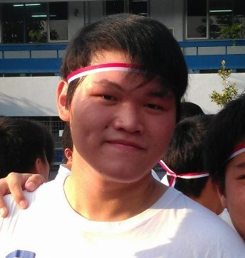
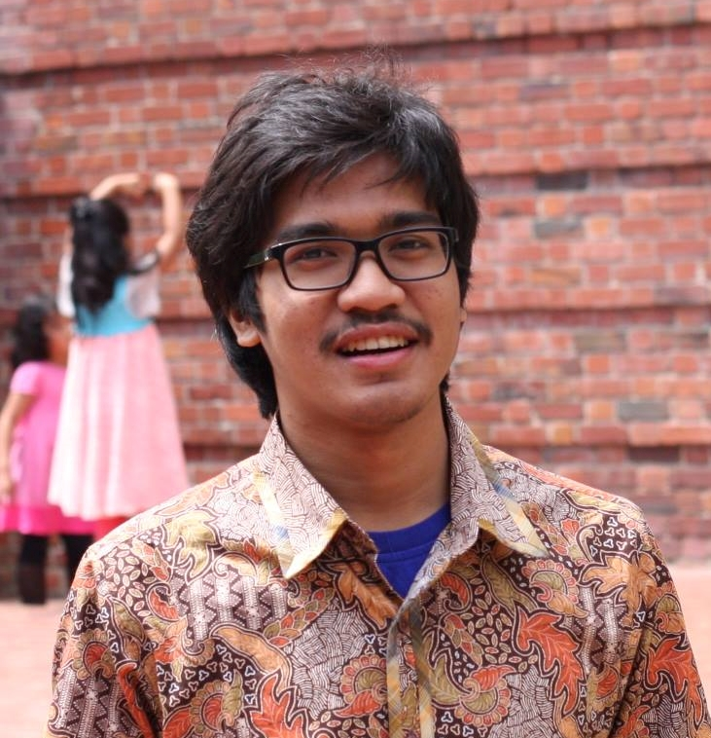
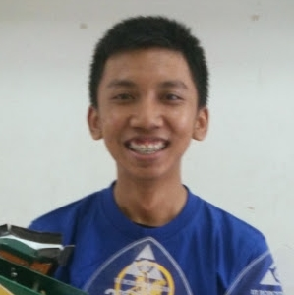
The Team
ART

Slide 3
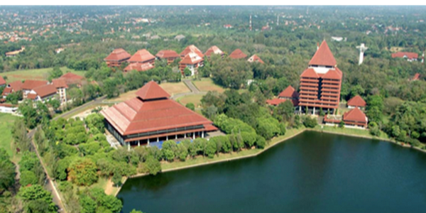
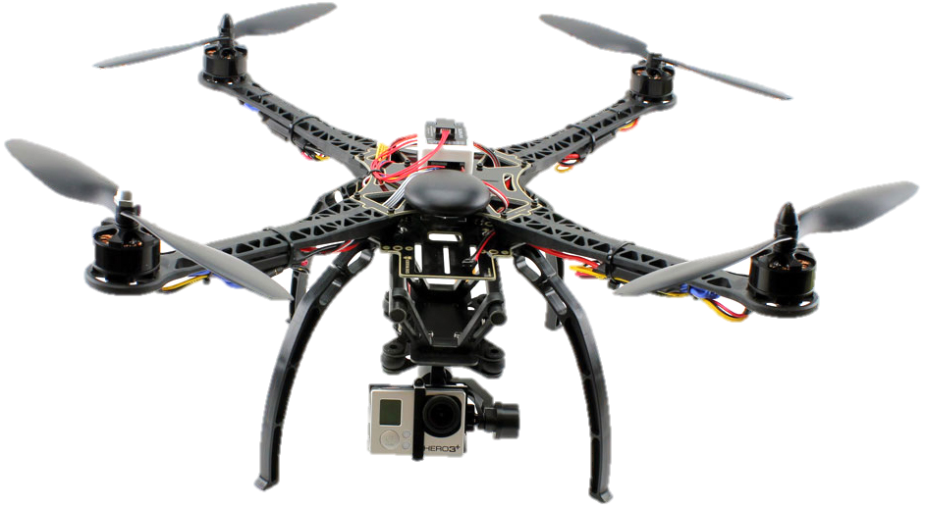

Project Overview
Referensi :
http://droneselect.com/wp-content/uploads/2015/02/51Nk8iyrmLL._SL1000.jpg
http://beingandroid.com/wp-content/uploads/2011/12/android_voice.jpg?584900
http://kanalsatu.com/images/20150514-154646_44.png

Slide 4
Project Deliverables
Phase | Deliverables | To whom |  | Format |  | Month
 |  | Project Leader | Customer | Electronic Form | Paper Form
UR | URD | v | v | v | v | TBA
 | SPMP | v |  | v | v | TBA
 | SRD | v | v | v | v | TBA
 | STP | v | v | v | v | TBA
SR | ADD | v | v | v | v | TBA
 | ITP | v | v | v | v | TBA
AD | DDD | v | v | v | v | TBA
 | UTP | v | v | v | v | TBA
DD | SUM | v | v | v | v | TBA
 | STD | v | v | v | v | TBA
 | Source Code | v | v | v |  | TBA

Slide 5
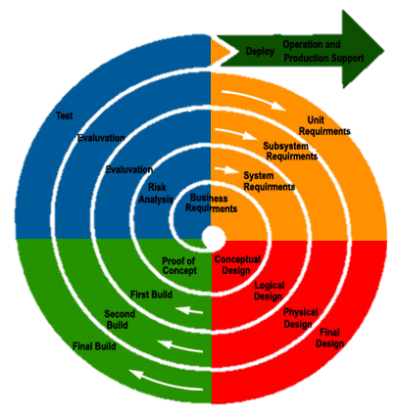
Spiral Model
Referensi :
https://eternalsunshineoftheismind.files.wordpress.com/2013/03/images_idce.jpg

Slide 6
Organizational Structure
Main Role | Additional Job | Name | email | Institution
Project Team Member | Hardware Developer | Aldwin Akbar Hermanudin | aldwin.akbar@ui.ac.id | Faculty of Engineering University of Indonesia
Project Team Member | Software Developer | Rudy Nurhadi | rudy.nurhadi@ui.ac.id
Project Team Leader | Software Designer | Tomi | tomi@ui.ac.id

Slide 7
Project Responsibilities
Role | Description | Person
Project Team Leader | Planning and coordinating team activities; Providing feedback about team progress; Motivating Team Member; Chairing reviews of the items made by his team. Additional Job: Software designer | Tomi
Project Team Member | Main Job: Assisting the team leader, Checking Progress, Defining work packages and Goals; Additional Job: Hardware Developer | Aldwin Akbar
Project Team Member | Main Job: Assisting the team leader by signaling problem in an early stage; Additional Job: Software Developer | Rudy Nurhadi

Slide 8
Management Objectives and Priorities
The objective of managing this project so well is because we have to use our time and cost needed efficiently in order to serve a high quality product. As a team leader must be able to plan and monitoring the output quality and make sure that the project is running based on guidelines.
Project Dimension | Fixed | Constrained | Flexible
Schedule | X
Cost |  | X
Changes Over Product |  |  | X

Slide 9
Assumptions, Dependencies, and Constraints
In this project plan, the schedule must be really strict because we are avoiding of running out of time and we have to minimize the consumption of so many cost that may comes up during doing this project. Also, a number of factors are taken into account, for instance: we still have a responsibility out of this project since we are still an engineering student and lack of ability to manage a project well and we are now learning how to implement managerial thing over the technical.

Slide 10
Risk Management
Risks with the work process : Time shortage and deadlines, Design Errors, Miscommunication
Risks with the management : The absence of Project Team Leader
Risks with the resources : Risks with the resources
Risks with the customer : Lack of meeting intensity with the customer, The customer requirements are not possible

Slide 11
Monitoring and Controlling Mechanisms
Weekly Meeting Project Team
Project Log - GitHub

Slide 12
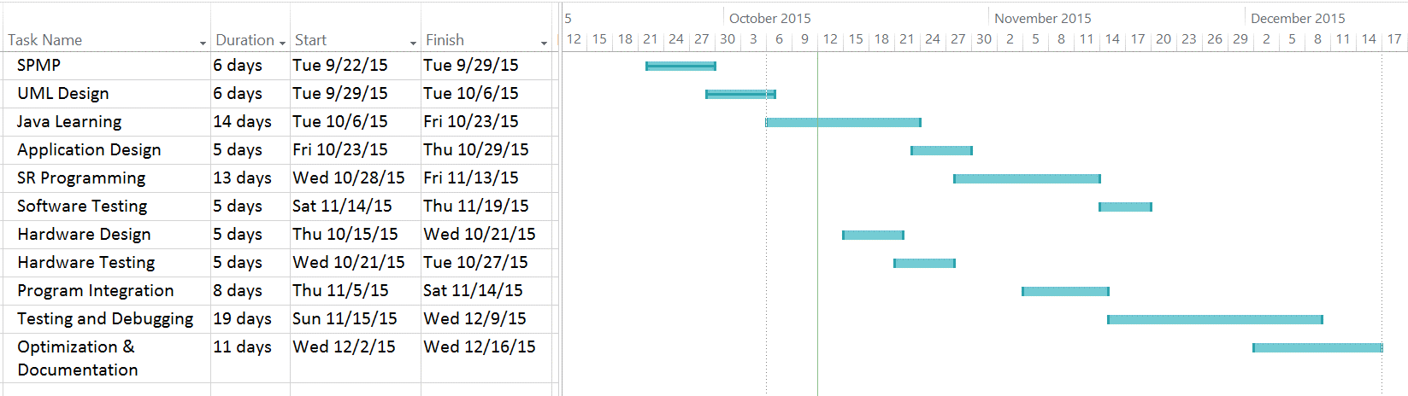
Schedule

Slide 13
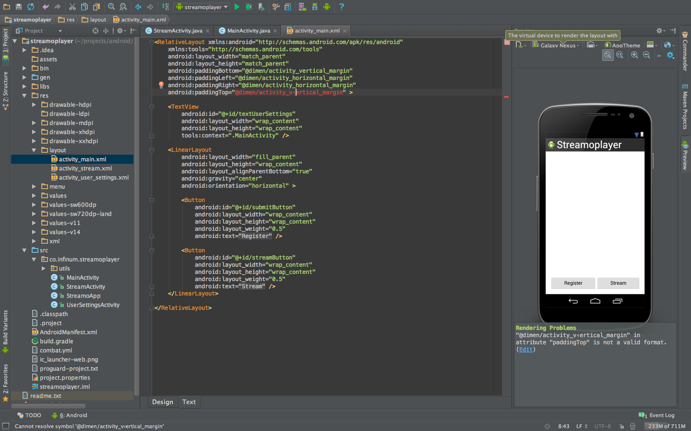
Software Tools
Android Studio
Referensi :
https://s3.amazonaws.com/infinum.web.production/repository_items/files/000/000/168/original/android-studio-3.png?1393599622

Slide 14
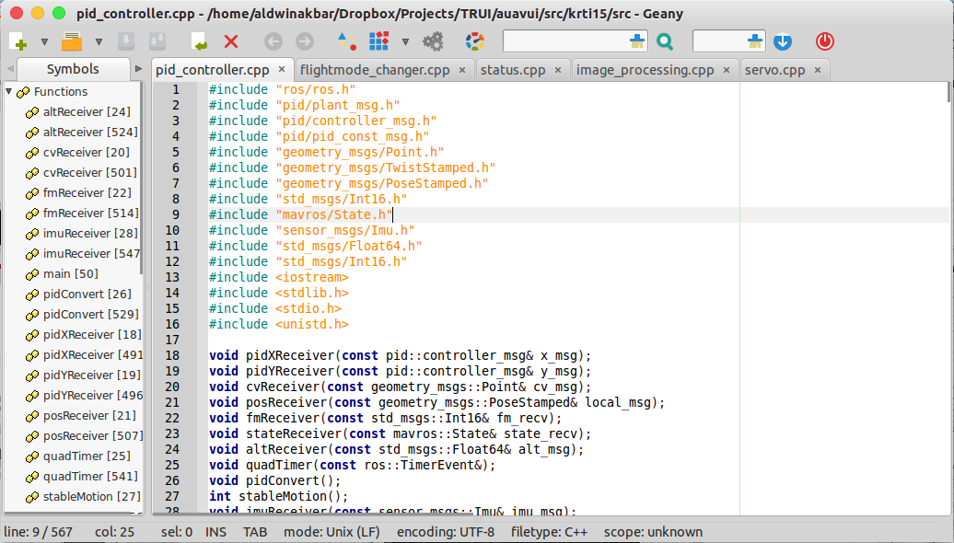
Software Tools
Geany

Slide 15

Software Tools
Robotic OS
Referensi :
http://www.active8robots.com/wp-content/uploads/ros.png

Slide 16
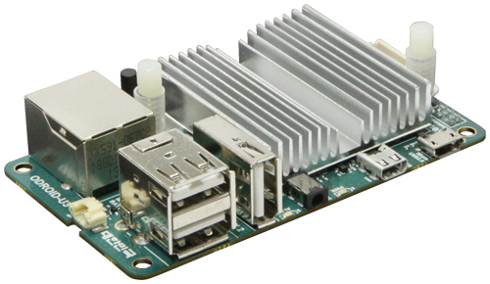
Hardware Tools
Odroid U3
Components | Detail
CPU | 1.7 Ghz QuadCore
Memory | 2GB LPDDR2
DC Input | 5V/ 2A
USB Host | 3 Ports
Storage | uSD and eMMC
Referensi :
http://dn.odroid.com/homebackup/201312222305368236.jpg

Slide 17
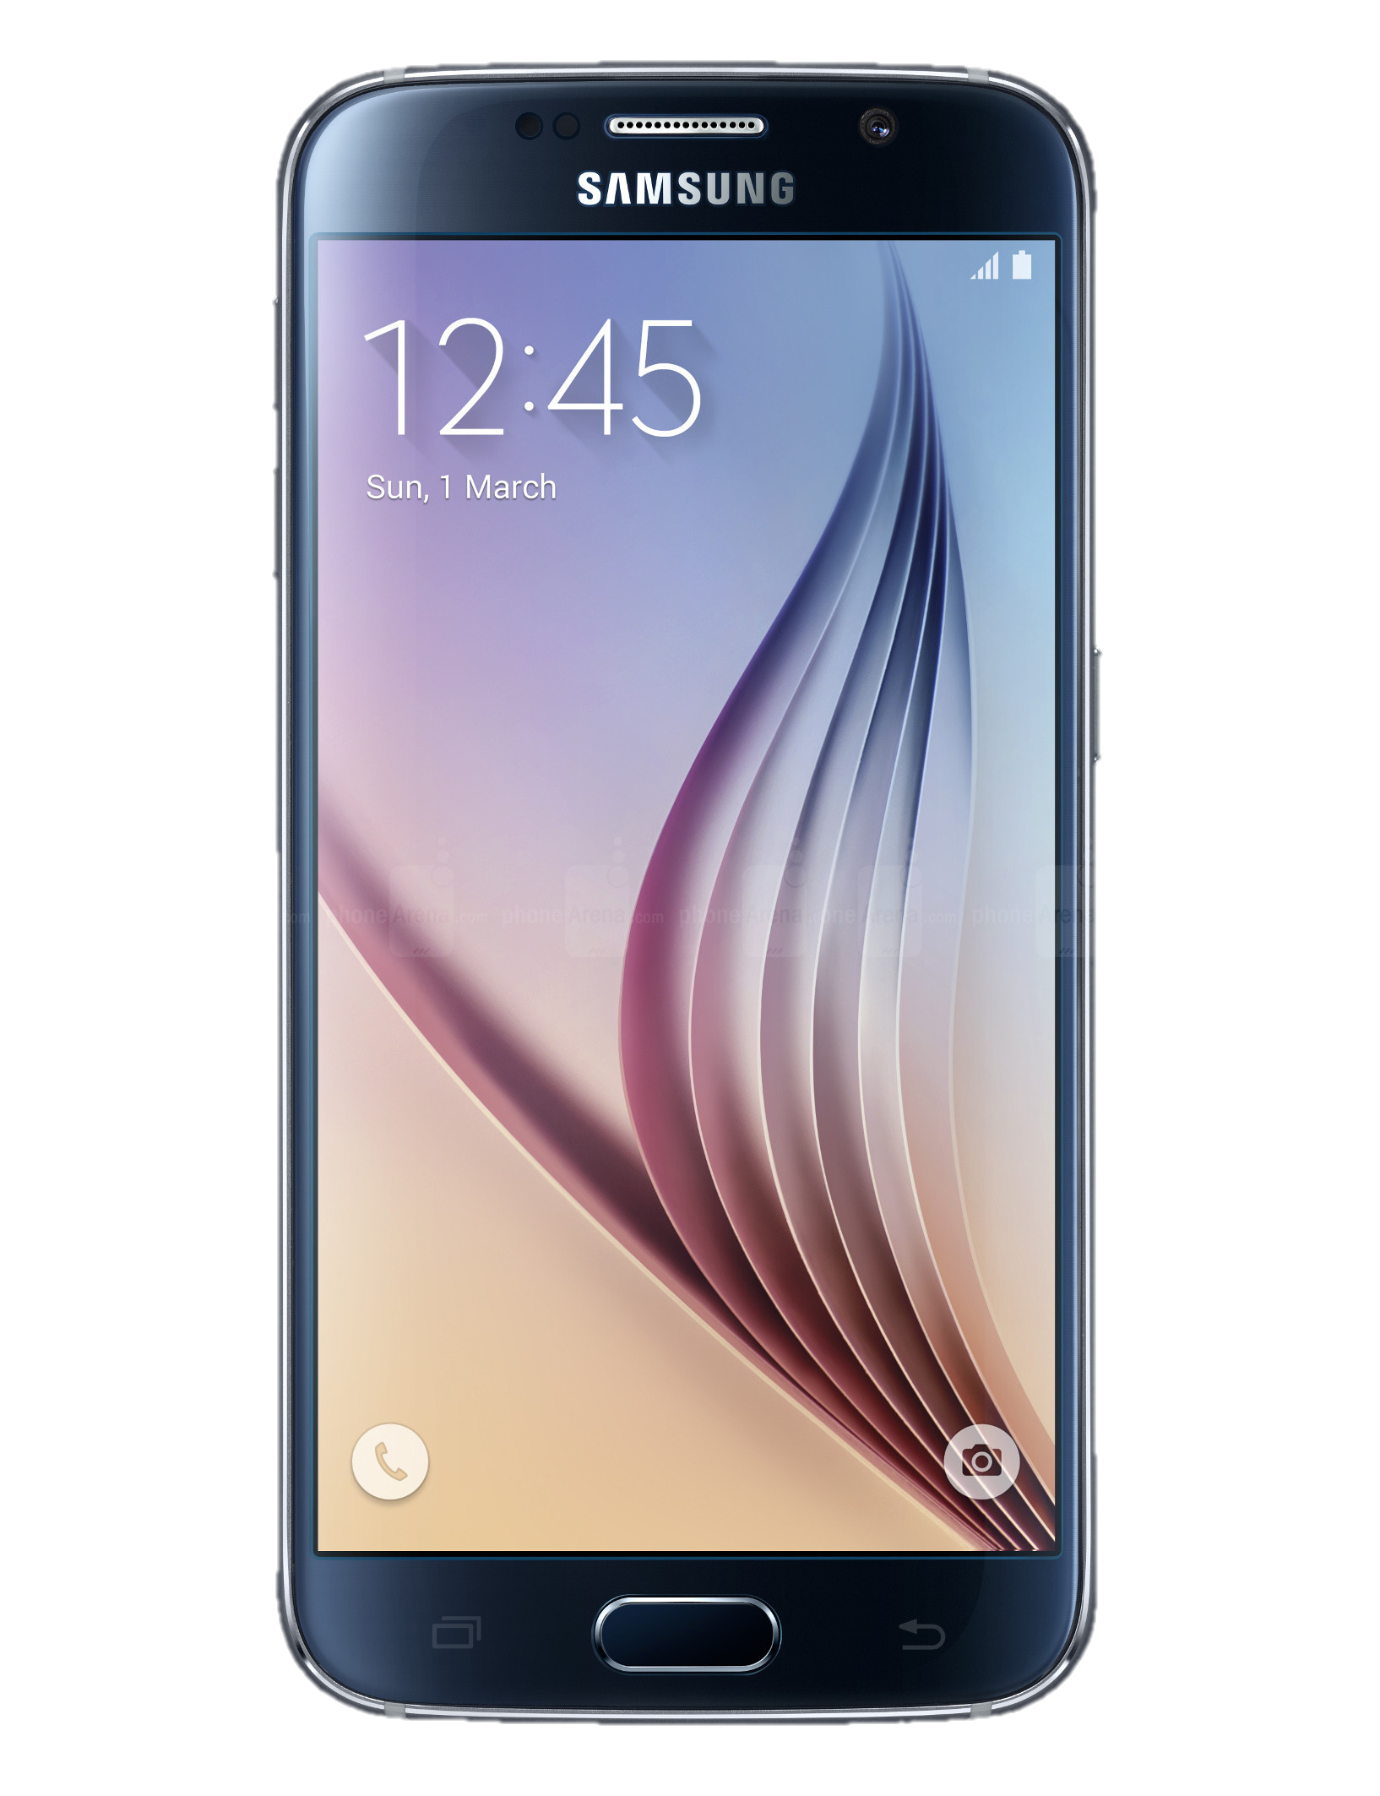
Hardware Tools
Android Phone
Minimum Requirements
Components | Detail
CPU | 1.2 GHz
Memory | 1GB RAM
OS | Android Kitkat
Connection | 3G Data
Storage | 8GB
Referensi :
http://i-cdn.phonearena.com/images/phones/51975-xlarge/Samsung-Galaxy-S6.jpg

Slide 18
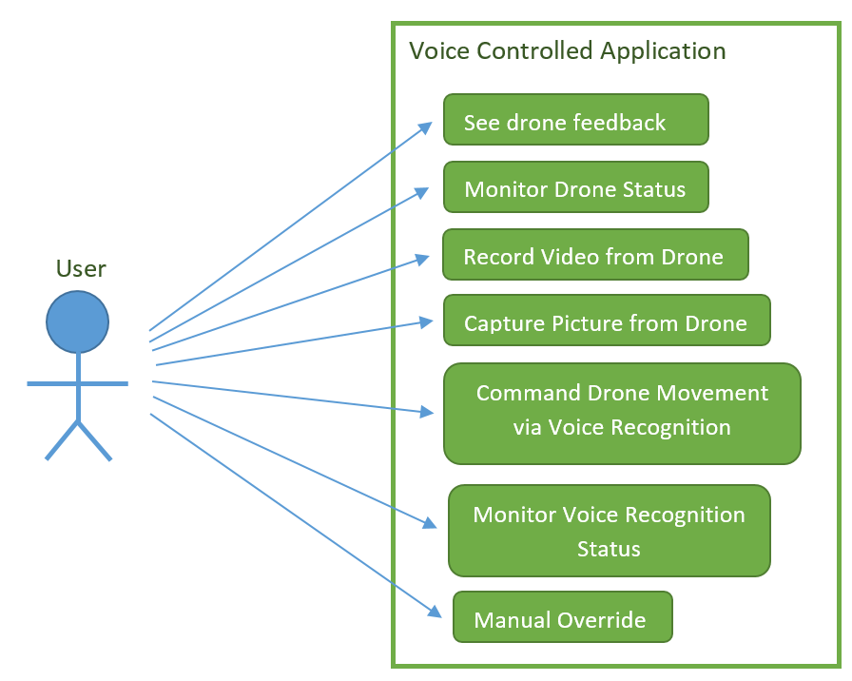
Case Diagram

Slide 19
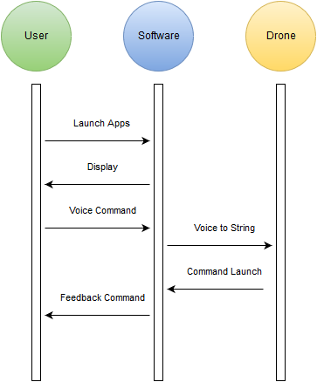
Sequence Diagram

Slide 20
Deployment Diagram

Slide 21
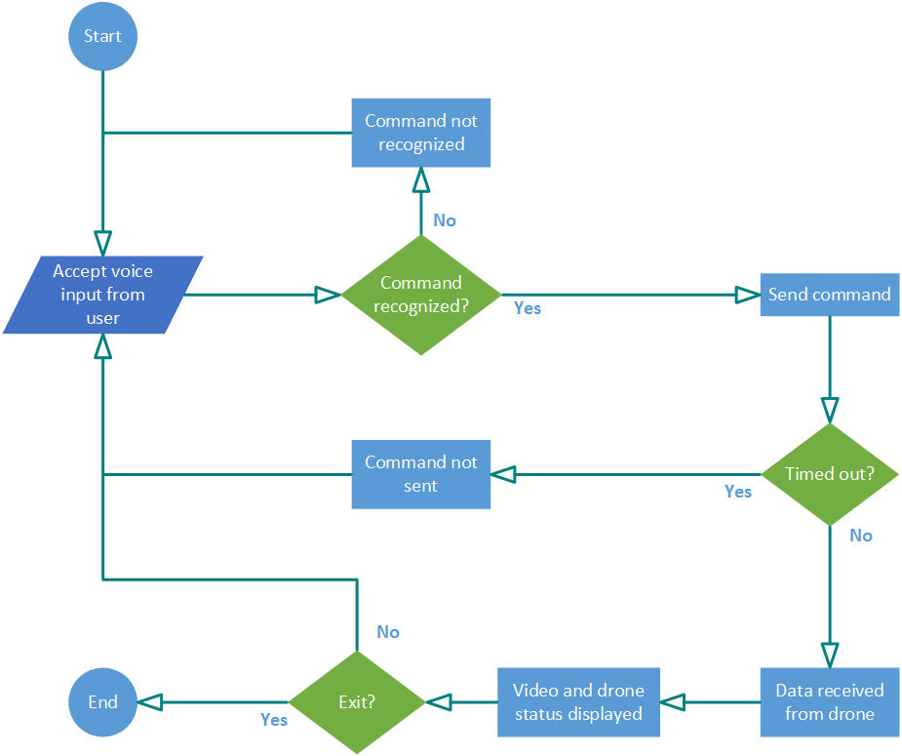
Activity Diagram

Slide 22
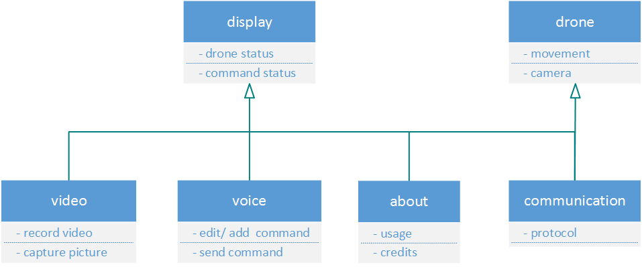
Class Diagram

Slide 23
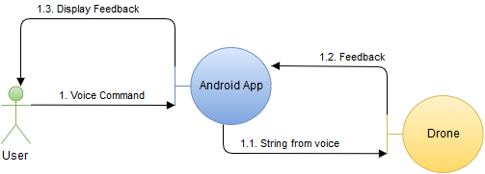
Communication Diagram

Slide 24
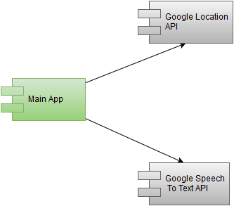
Component Diagram

Slide 25
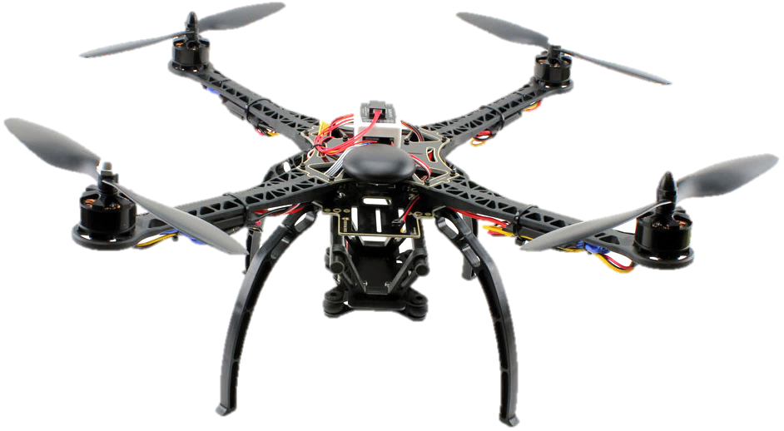
How it would probably looks!

Slide 26
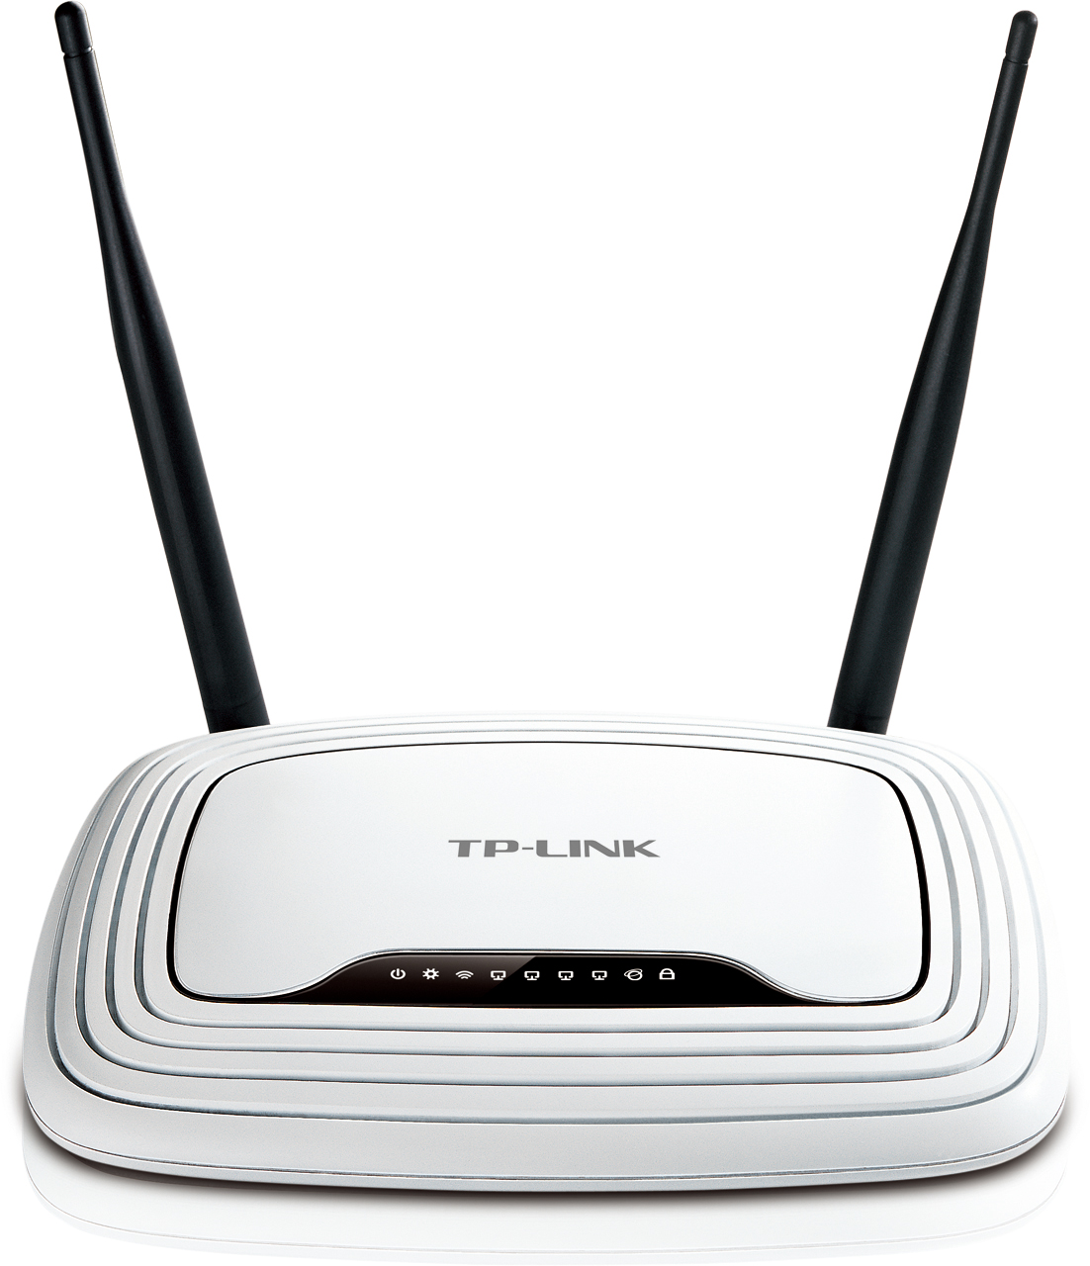
Implementation
Short range control using 2.4GHz Radio
Command-line based, direct text instruction without voice recognition, Simple movement
Drone Video & Status
Referensi :
http://www.sinetworks.in/wp-content/uploads/2014/07/TL-WR841N.jpg

Slide 27
Testing Risk/Assumption

Slide 28
Unit Testing
Item to Test | Test Description | Test Date | Responsibility
Android Application | The android application will be tested as of the performance and the design of the application to meet the acceptable user interface application | 25/11/2015 | Team
Drone | Drone needs to be able to do basic command such as ascending and descending, whereas the drone hardware integrity need to be maintain. | 25/11/2015 | Team
Data Communication | The connection between the application and the drone through the internet | 27/11/2015 | Team

Slide 29
Test Criteria
Test Pass / Fail Criteria
The system being tested pass if all the function will work as the requirements. If a failure occur than the test is said to be fail.
Test Entry / Exit Criteria
The beginning of the test will be with testing the application function to the drone. The test will stop after all function and commands is tested.
Test Deliverables
In the end of the testing the deliverables would be the test survey by user to improve the system, the report result of the test and the test analysis documents. The survey is necessary in order to evaluate through the user experience in using the application.

Slide 30
Test Criteria (Cont.)
Test Suspension / Resumption Criteria
The test will be suspend if an inevitable events shown such as a personal problems of the team members that he must attend or the weather condition that does not allow the project to be tested. In case such events occurred, the date of testing will be replace to an available date within week of the test.
Test Environmental / Staffing / Training Needs
In testing the project all staff does not need any training or skill to be able to conduct the test. The team only needs to know how to use an android applications by following the user guide.

Slide 31
User Testing Form Criteria
System Testing
System have to provide any information regarding response time and time delay.
Consistency and Standard
System have to use the standard naming and the system need to be consistent.
User Interface
The design have to be appealing and easy to use.

Slide 32

Application Logo

Slide 33

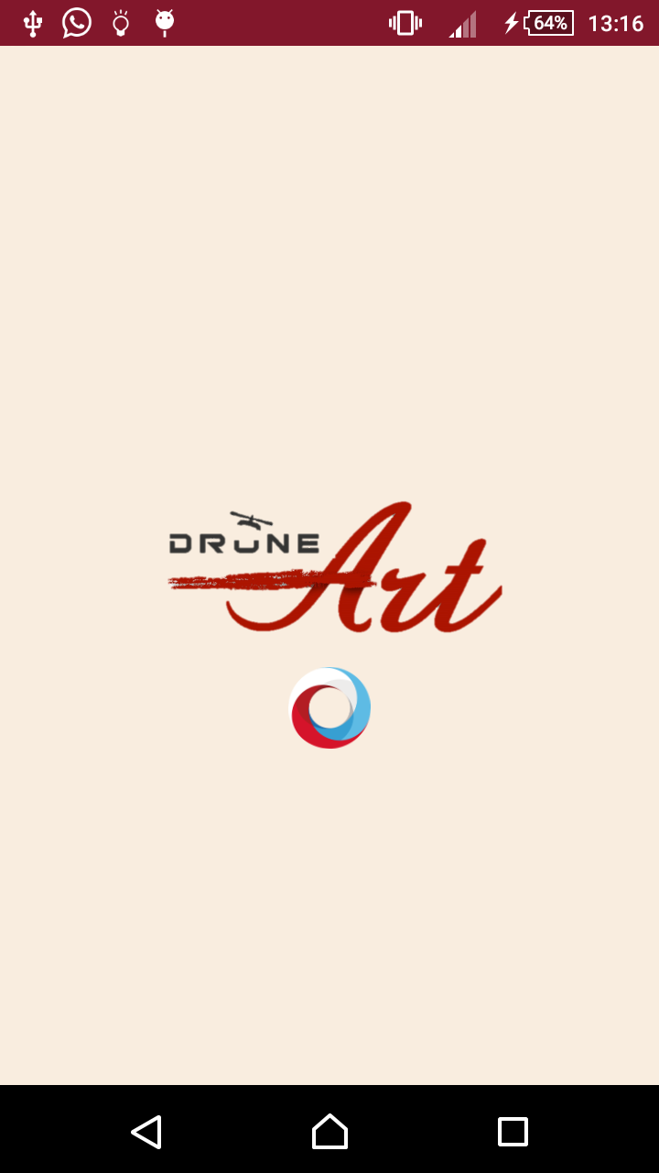
Splash Screen

Slide 34
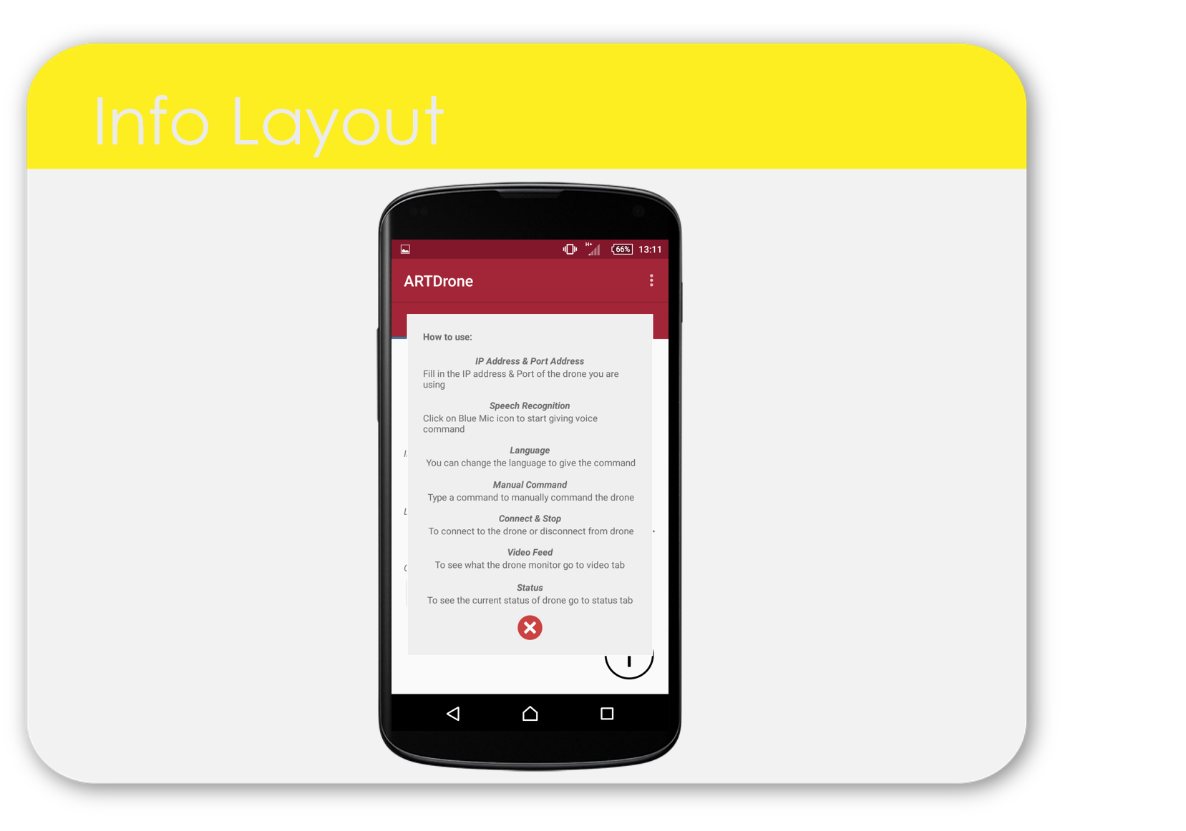
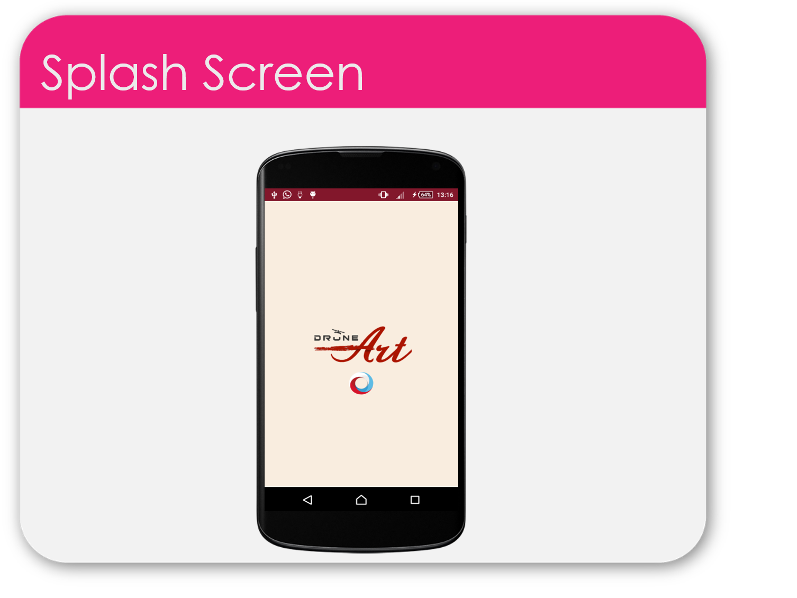
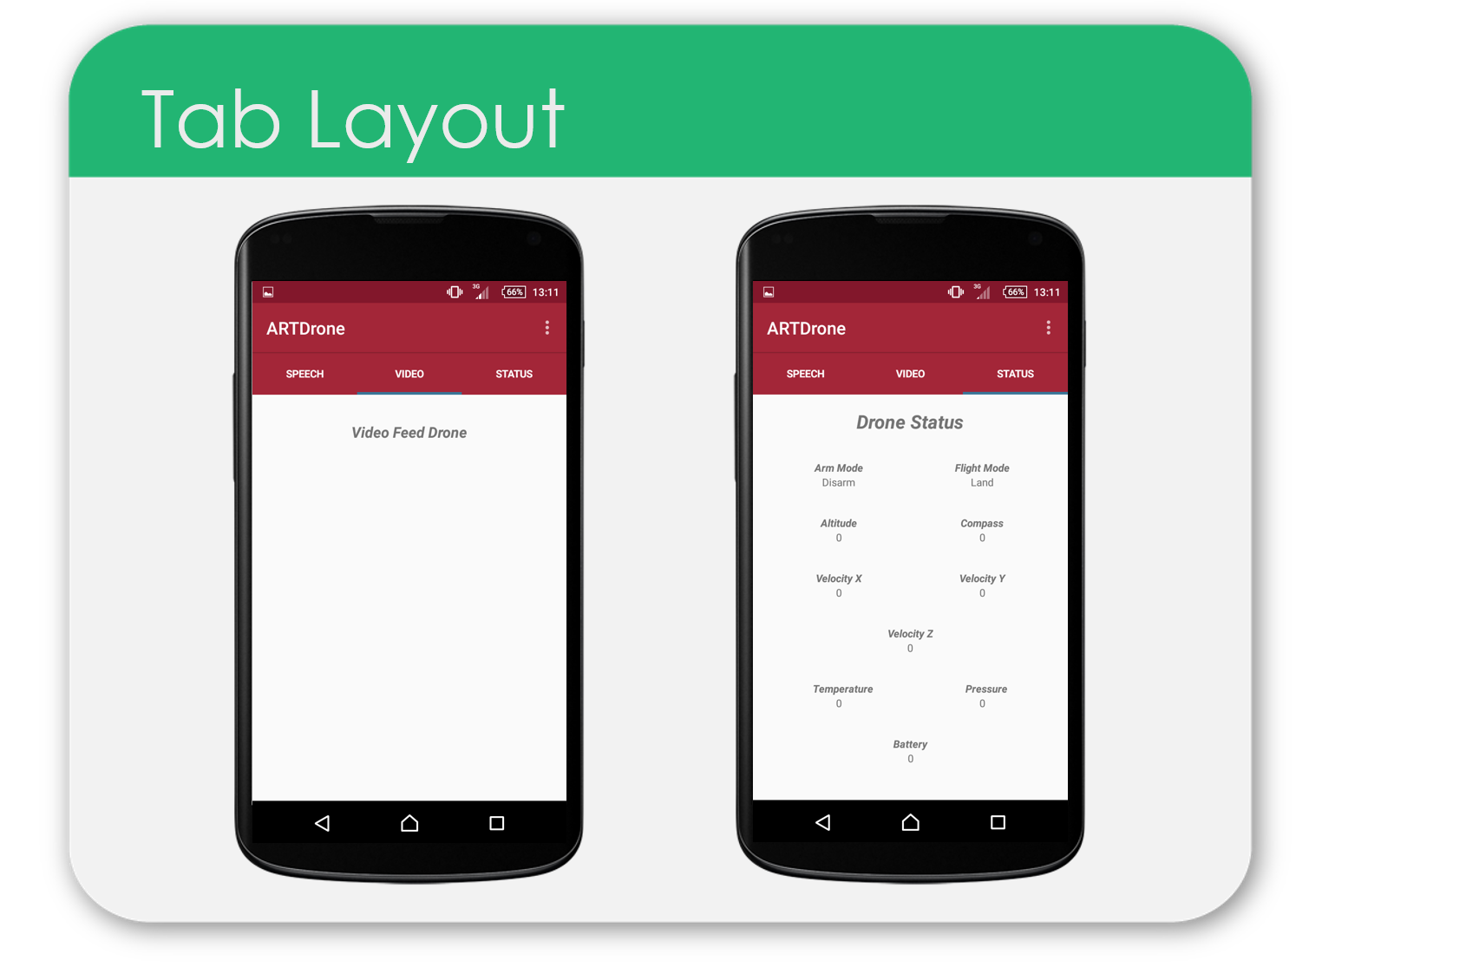
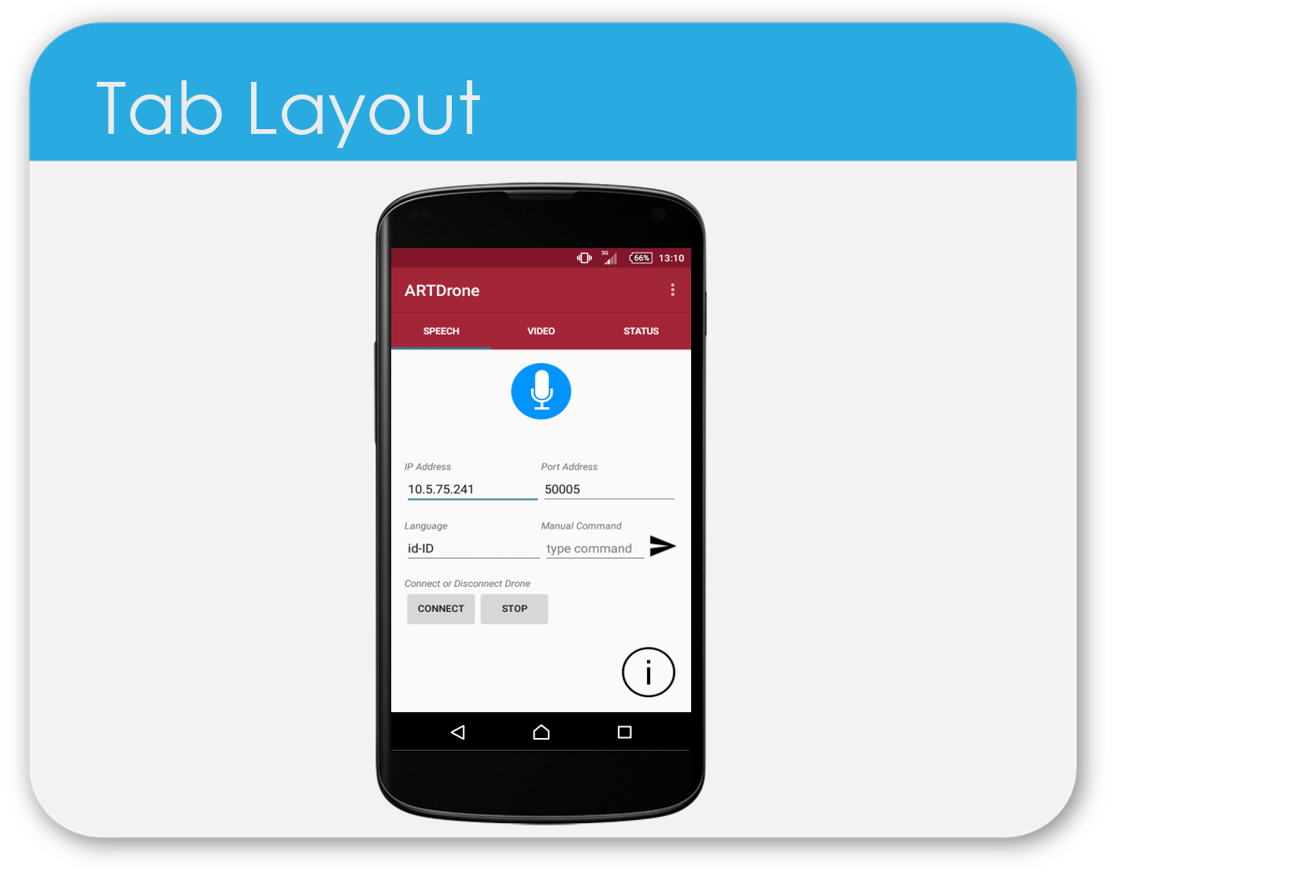
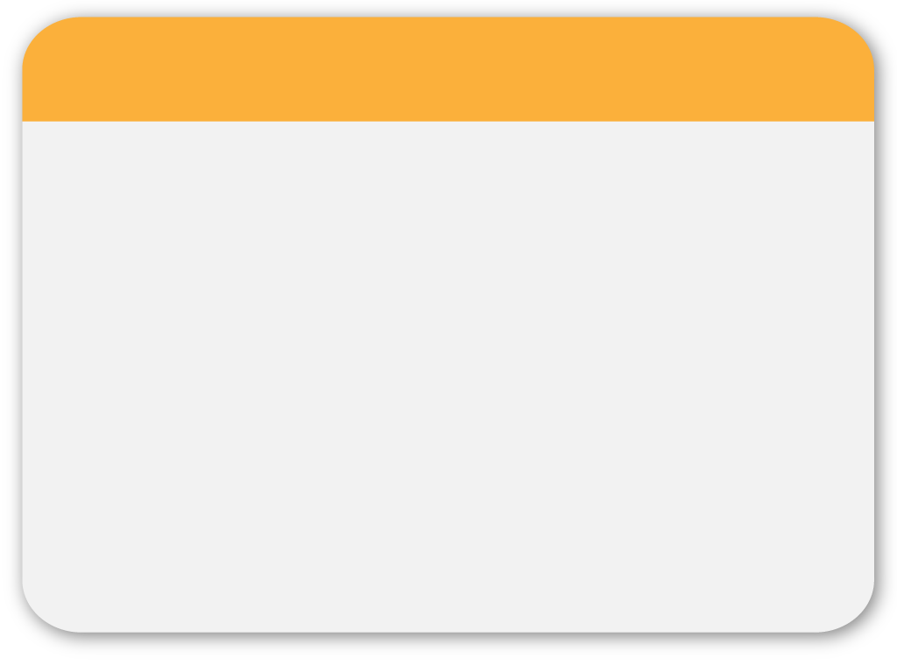
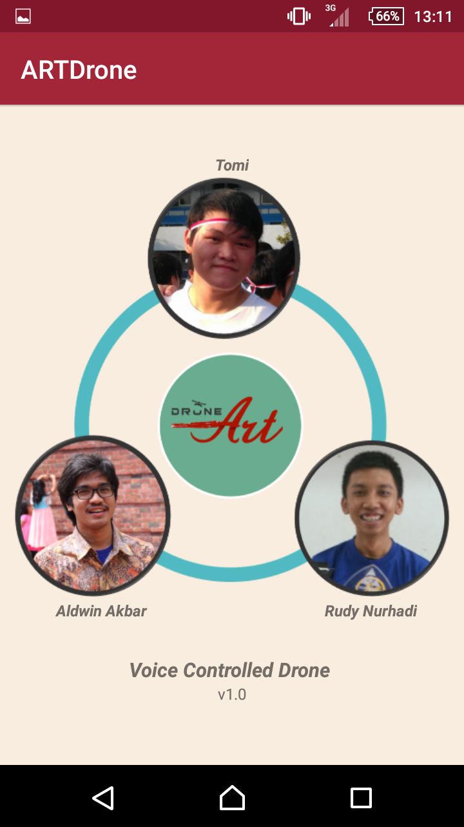
About Application

Slide 35


